Slide 1

Cybersecurity Training Project: Overview
This project aims to boost cybersecurity awareness through practical training.
It offers login simulation, educational content, interactive simulations, quizzes, and security tips targeting employees and individuals seeking skills.

Slide 2
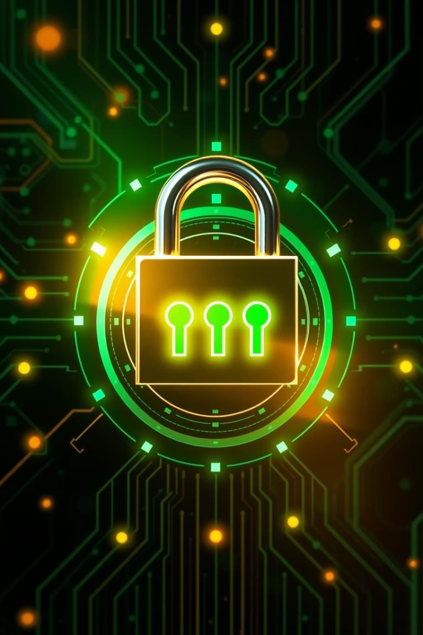
Login Simulation: Strengthening Password Security
Realistic Login Scenarios
Historic Breaches
LinkedIn (2012) exposed 164 million accounts; Yahoo (2013) had 3 billion accounts breached.
Simulate common password vulnerabilities to teach best practices.
Strong Password Tips
Encourage complexity, length, uniqueness, and password manager use like LastPass and 1Password.

Slide 3
Educational Content: Building Cybersecurity Knowledge
Core Topics
Real Examples
Fundamental Security
Malware
WannaCry ransomware, 2017, >$4 billion damages
The CIA triad: Confidentiality, Integrity, Availability.
Phishing
Social Engineering
BEC scams causing $26 billion losses (2016-19)

Slide 4

Interactive Simulations: Mastering Threat Detection
Email Inbox Simulation
Spam Email Detection
Identify phishing emails; 1 in 99 emails is phishing.
Recognize spam; spam makes up 48.16% of email volume (2022).
Ransomware Simulation
Practice response; average ransom payment $228K, Colonial Pipeline paid $5M (2021).

Slide 5
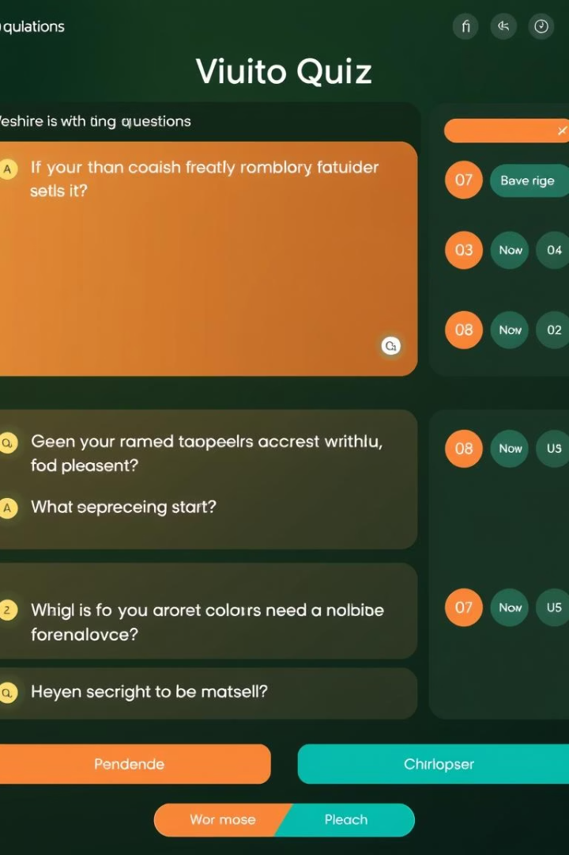
Quiz: Testing and Reinforcing Learning
Various Question Types
Multiple choice, true/false, and scenario-based.
Instant Feedback
Explanations for incorrect answers enhance learning.
Gamification
Points, badges, and leaderboards motivate users.
Progress Tracking
Monitors user improvement over time for continuous growth.

Slide 6
Security Tips: Practical Advice for Everyday Protection
Multi-Factor Authentication
Regular Updates
VPN Usage
Enable MFA on all critical accounts for extra protection.
Keep software and operating systems up to date to patch vulnerabilities.
Use VPNs on public Wi-Fi to secure your internet connection.

Slide 7
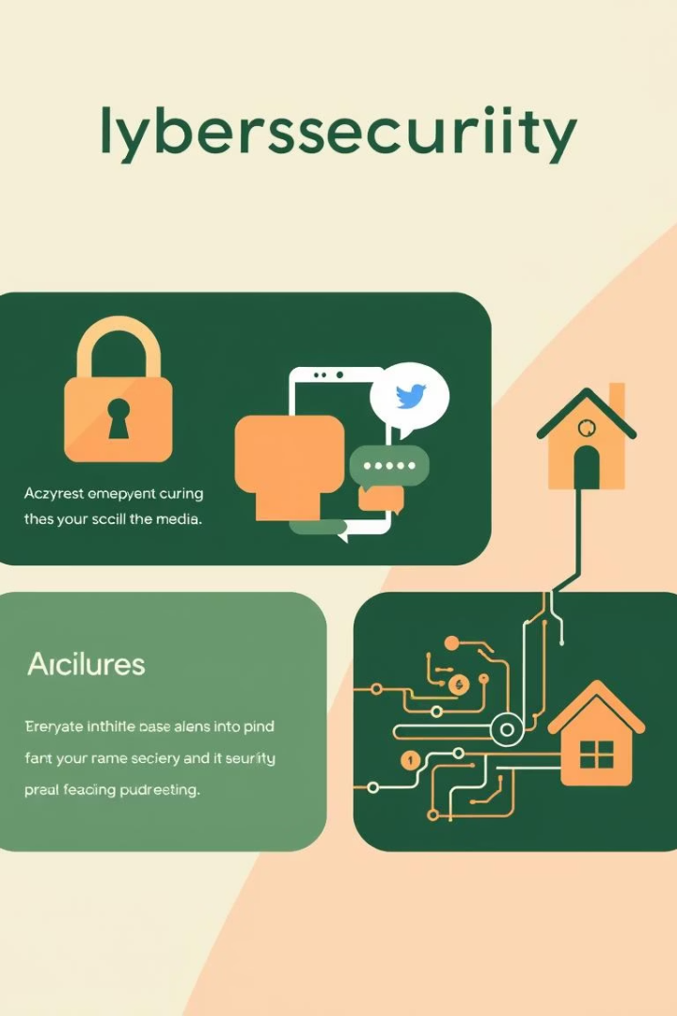



Cybersecurity Info Cards: Quick Reference Guides
Data Encryption
Social Media Security
IoT Device Protection
Protect sensitive information with strong encryption methods.
Manage privacy settings and be cautious of information shared.
Secure smart devices with unique passwords and software updates.

Slide 8

Conclusion: Empowering a Cybersecurity-Aware Culture
Future Plans
Foster Culture
Expand content, simulations, and features for continuous growth.
Summarize Benefits
Encourage ongoing responsibility and vigilance among users.
Project enhances awareness and practical skills.

